Slide 1
Road to Racial Justice
A Free Educational Board Game by Kesa Kivel

Slide 2
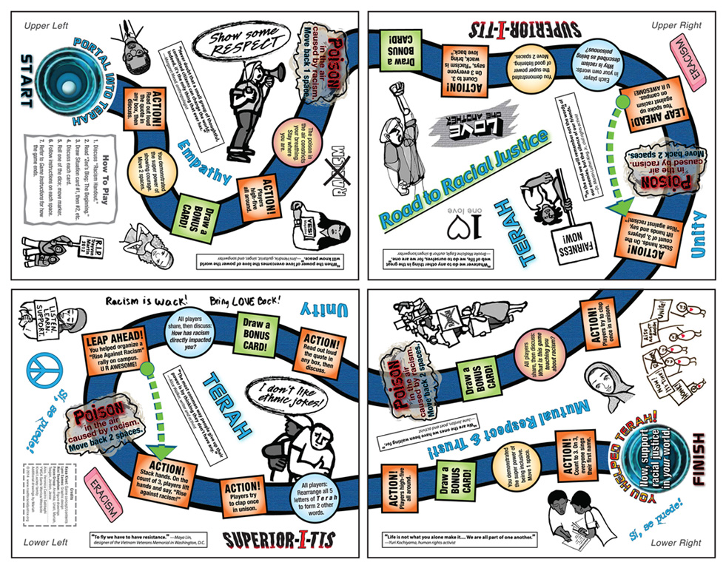

Slide 3
Purpose
Players will become more aware that racism exists in many everyday kinds of situations, learn why each situation is racist, and acquire tools to interrupt these situations.

Slide 4
Game Play
At the beginning of each turn, one team will select a situation and do what the card says
After responding to “Situation” cards that each describes a specific incident of racism, players move markers on the game board toward the finish line.

Slide 5
The “Situation” Cards
The Road to Racial Justice game begins with players responding to cards that describe different racist situations, some interpersonal and some institutional.
Every single situation on the game cards is based on a true-life event that actually happened.

Slide 6
“Everyday” Kinds of Racism
The situations are about “everyday” kinds of racism that we may not always know about or notice, unlike racist incidents involving police brutality and the burning of mosques, etc., which most people are aware of through media exposure.
To combat racism in ALL the places it exists, we need to understand just how widespread it is.

Slide 7
Systemic Racism
There are no cards in the game about hurtful acts against a white person because of their skin color. The reason: There is a difference between those hurtful but rare acts and the systemic — or ongoing and widespread — oppression of people of color that has occurred throughout U.S. history due to racist laws, practices, and policies.
People of color are affected by racism in many areas of their lives, not just in a few hurtful experiences, and not just by the kinds of racism that may be reported in the media.

Slide 8
Systemic Racism (Cont’d)
Hurtful acts against white people are wrong and not to be tolerated. It’s okay and natural for white people to be upset about them.
Everyone should be treated with respect!
But, again, individual acts against white people are different from the ongoing, widespread prejudice and discrimination against people of color.

Slide 9
Some things to think about before playing the game…

Slide 10
Knowledge Is Power
Related to racial injustice and the harm caused by it, white people live longer than people of color.
This is due to such things as the racial wage gap and the unequal access of people of color to healthcare and to a good education.
While it may seem overwhelming to learn about these things, we need this knowledge in order to take action against racism.

Slide 11
We Are Not The Enemy
None of us in this room is personally responsible for causing the racist laws, policies, and practices that we will be learning about.
The institutions and ideas that forged this injustice developed over a long time.
However, we can ALL take responsibility and intervene in positive ways to change the situation now.

Slide 12
Discomfort:
A Springboard For Change
Being part of a society where racist laws, policies, and practices exist, you may realize that you have engaged in some racist thinking or behaviors in the past.
Feelings such as guilt, shame, anger, depression, or hopelessness may arise.
After you identify your feelings and allow yourself to feel them, you have a choice:

Slide 13
Discomfort:
A Springboard For Change
You can stay angry, ashamed, overwhelmed, etc., OR you can be compassionate and forgiving with yourself and then put your “emotions into motion” to help create a more just world.
The game will give you some specific ways to intervene. You can make a difference!

Slide 14
White Privilege
A term coined by white antiracist activist Peggy McIntosh that refers to unearned advantages that white people have because of societal racism, even if they are poor or uneducated and don’t seek out these advantages.
For example: if people of color don’t get jobs because of racial discrimination, white people have more job opportunities (an advantage).

Slide 15
To Start:
Discuss the terms in the “Racism Handout.”
Read “Zee’s Blog: The Beginning.”
Go through the situation cards in order — #1 first, then #2, #3, etc. — so that you can follow the storyline in the cards as the game is played.
  READ THE CARD FIRST, RESPOND,
  THEN ROLL THE DICE!
Follow the instructions on whatever type of card you have drawn (Choice, Racism Handout, Thumbs Up/Thumbs Down).
On each space on the game board that your marker lands on, follow the instructions.

Slide 16
To Finish:
To finish the game, you must roll a number so that your marker lands directly on FINISH.
For example: lf you need a four to land on FINISH but you roll a five, you stay where you are.
After landing on FINISH, continue drawing cards, but do not roll the dice or move your marker.
The game is over when all teammates have crossed the finish line.

Slide 17
After Finishing
Read any unread blog entries from “Zee’s Blog: The Conclusion.”
Follow with a group discussion.

Slide 18
What you need to begin
Divide the group into teams of 3-5 people.
A Marker for the gameboard that represents each team.
A single 6 sided die.
Each play needs a player handout containing Zee’s Blog: The Beginning and the Racism Handout
Facilitator needs a copy of “Zee’s Blog: The Beginning”
A set of “Bonus Cards”
Have the teams take turns reading through the following slides until you get to the slide that says “Begin the Game”

Slide 19
Stereotyping
Making a statement, usually offensive, based on the mistaken belief that all people of a particular gender, age, race, ethinicity, etc. are the same. Examples of racial/ethinic stereotypes include statements that begin with:
“All blacks are…” “All Asians are…”

Slide 20
Prejudice (an attitude)
Disliking someone based on gender, age, race, etc.
Racial prejudice is usually based on physical characteristics such as skin color, nose shape, eye shape, or hair texture.
If you act on your prejudice, it becomes discrimination.

Slide 21
Discrimination
Unequal treatment of someone because of the person’s gender, age, race, etc. Examples of racial discrimination include:
  Individuals harassing another person just because of their skin color.
  Institutions (such as the government, the military, religions, or the media) that are mostly controlled by white people and that create policies, practices, and laws that are unfair to people of color.

Slide 22
Cultural Appropriation
The use – without permission or proper context – of the dress, music, art, traditions, or social behavior of an oppressed people by a group that is in a position of greater power. For example:
Although headdresses are sacred to American Indian tribes in the great plains region and elsewhere, a clothing store dressed a fashion model in a “Native American” headdress for its fashion show.

Slide 23
Joking or teasing
(some examples)
Telling a joke about the Holocaust in front of Jewish people.
Wearing a Halloween costume that makes fun of a certain race/ethnicity.

Slide 24
One-sided presentation of history.
The presentation of history from only one point of view instead of from multiple historical perspectives.
For example: Most school textbooks leave out the point of view of the Taíno people and other Native American tribes whom Christopher Columbus and his men enslaved and killed.

Slide 25
Tokenism
Including someone as “token” (a symbol) to represent their race rather than valuing that person as an individual with unique talents and skills.
In this way an “image” of diversity is constructed, but a white norm is maintained.
For example: In an attempt to appear diverse, a TV or movie director casts on black person as the sidekick in an otherwise all-white cast.

Slide 26
Zee’s Blog: The Beginning
Facilitator Reads the Blog Entry

Slide 27
Begin the Game
The following slides are the situation cards.
The first team reads the situation card and follow’s the actions. All teams talk about the situation group in their teams. To end your turn you roll the die and move your marker.

Slide 28
Begin the Game
The following slides are the situation cards.
The first team reads the situation card out loud and follow’s the actions.
To end your turn you roll the die and move your marker.
Where you land may inspire another action.
Once initial team’s actions have been completed the next team will read the next situation and follow.
Play will end when all teams successfully land on the “Finish” Space

Slide 29


Slide 32
Just a reminder as you play:
Every situation described in the cards is based on a real event.
None of the interventions in the cards are wrong. The way you choose to intervene in each situation will depend upon your upbringing, personality, education, and other factors.
c) It’s okay to have a different response to the
situations than your teammates.

Slide 44
Just a reminder as you play:
Every situation described in the cards is based on a real event.
None of the interventions in the cards are wrong. The way you choose to intervene in each situation will depend upon your upbringing, personality, education, and other factors.
c) It’s okay to have a different response to the
situations than your teammates.

Slide 53
Just a reminder as you play:
Every situation described in the cards is based on a real event.
None of the interventions in the cards are wrong. The way you choose to intervene in each situation will depend upon your upbringing, personality, education, and other factors.
c) It’s okay to have a different response to the
situations than your teammates.

Slide 63
Just a reminder as you play:
Every situation described in the cards is based on a real event.
None of the interventions in the cards are wrong. The way you choose to intervene in each situation will depend upon your upbringing, personality, education, and other factors.
c) It’s okay to have a different response to the
situations than your teammates.

Slide 74
Just a reminder as you play:
Every situation described in the cards is based on a real event.
None of the interventions in the cards are wrong. The way you choose to intervene in each situation will depend upon your upbringing, personality, education, and other factors.
c) It’s okay to have a different response to the
situations than your teammates.

Slide 78
Before the game ends…
Are there any blog entries from Zee that haven’t been read yet? Go through the remaining situation cards and read any remaining blogs out loud!

Slide 79
Congrats!
You helped Zee and Terah!
Hopefully you also learned a lot about racism that occurs in our everyday world and maybe times that we’ve participated in racism.
Take some time and debrief as a group.
  Use the questions from the player feedback form or on page 28 of the game instructions.

Slide 80
Thanks for playing!
If you would like share this resource with others please reach out to the CommUnity Zone or go directly to www.roadtoracialjustice.org

